Slide 1
CSI 342 2013-2014 SYSTEMS ANALYSIS AND DESIGN
LECTURER : DR E U OKIKE
MWF 12.00noon
232-10

Slide 2
LECTURE 1- BASIC DEFINITIONS: SYSTEMS, ENVIRONMENT AND INTEGRATION OF TECHNOLOGIES
OBJECTIVE: At the end of this lecture, students are expected to :
Be able to explain the basic concept of a system
Understand the elements of s system
Recall the basic types of computer based systems
Realize what the many roles of a systems analyst are

Slide 3
What is a System?
A system is set of components that interact with one another to accomplish a purpose or goal.
Within this basic definitional framework, elements necessary for the very existence of any system may be identified.
These elements include the environment, boundaries, input/output, and components

Slide 4
System Environment
This refers to the surroundings of a system, both affecting and being affected by it.
What we call the environment depends on the system’s goals, and activities, as well as whether it is a physical or an abstract system
Hence, different environments can be defined for different systems.
The environment is a function of the individual who is observing or interacting with the system.

Slide 5
System boundary
System boundaries separate or distinguish the environment from the system.
The system exists, within the boundaries, and anything lying outside them constitutes the environment
The system’s boundary line determines what is included within the system and what is not.
The particular characteristics of a boundary vary according to whether a system is physical or abstract

Slide 6
System boundary Contd
In a physical system, the boundary is a natural line of demarcation determined by the basic system structure and the system’s goals and purposes.
In abstract systems, boundaries are typically imposed by the observer. The arbitrary boundary line may therefore vary from observer to observer, unless everyone can agree on criteria for its selection. Under any circumstances, the abstract system’s boundaries are determined by the observer’s level of inquiry, the intent and purpose in drawing the line, and the observer’s perceptions of the internal working of the system

Slide 7
Abstract and Physical systems
Abstract Systems are conceptual models i.e exist as intangible concepts . Example: studying the inter personal behavior in a social group or studying the personality trait of individuals
Physical systems generally are tangible. The elements (or components) of a physical system interface with one another to enable the system achieve its functions Examples: A Computer system, a thermodynamic or power and energy system. Both systems have tangible physical components which allow exchange of matter : information or energy between components
..

Slide 8
Open and Closed systems
An open system has a discrete number of interfaces to allow the exchange of matter, energy or information with its surrounding environment. That is, an open system has an external interface in which matter, energy, information goes from outside to one or more internal element(s), which transduces this input via the original or other element(s) (e.g., by passing it among internal elements via internal interfaces), and an external interface through which results flow from some one or more internal element(s) to outside the system. .

Slide 9
Closed system
A closed system is self-contained in such a way that outside events have no influence upon the system. In this case there is no possible exchange of matter, energy or information with the surrounding environment. After a period of time all internal activity within a closed system will stop.

Slide 10
BASIC SYSTEM ENVIRONMENT DIAGRAM
INPUT
PROCESS
OUTPUT
Environment
Boundary

Slide 11
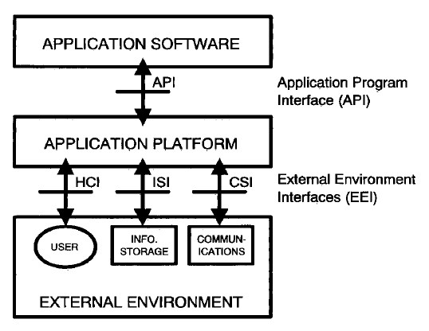
Computer based system Environment
HCI-Human Computer Interface
ISI- Information Storage Interface
CSI- Communication Systems Interface
 | JPG

Slide 12
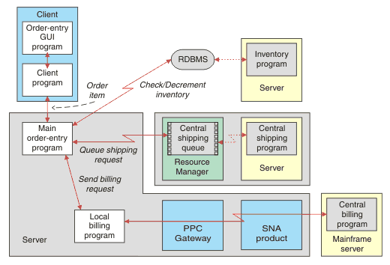
Order entry application program
Note
Several servers
Severs linked
Different programs within severs

Slide 13
TYPES OF COMPUTER BASED INFORMATION SYSTEM
Analysing Computer based Information Systems (IS) requires:
Clear understanding of what they are and what they do
Clear understanding of their operational environment (their organizational context)
Clear understanding of how they operate
Clear understanding of the enabling technologies (hardware and software)

Slide 14
Types of Computer Based Systems
All Systems are part of a larger system
For Computer Based Information Systems, the following are examples:
Management Information System (MIS)
Decision Support System (DSS)
Transaction Processing System (TPS)
Office Automation System (OAS) and Knowledge Work Systems (KWS)
Enterprise Systems (Also called Enterprise Resource Planning System (ERP))
Group Decision Support Systems (GDSS) and Computer Supported Collaborative Work systems (CSCWS)

Slide 15
Types of Computer Based Systems
Artificial Intelligence (AI)and Expert Systems
Executive Support Systems (ESS)
Systems for Wireless and Mobile Devices
Open Source Systems
Assignment 1 : What do these different types of Computer Based Information systems do ?
A systems analyst may be involved with any or all of these systems

Slide 16
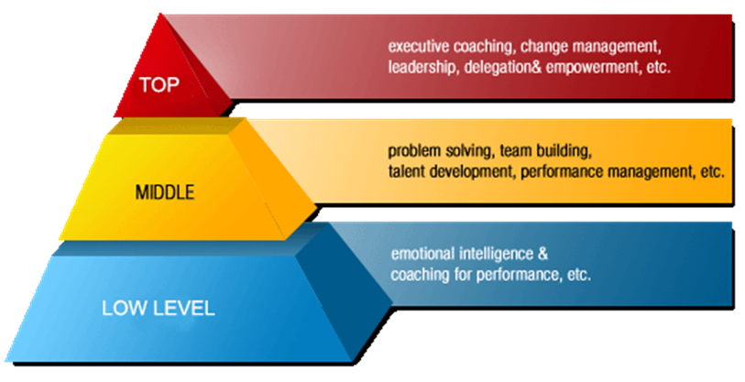
Levels of management Systems Analysts may work with in organizations

Slide 17
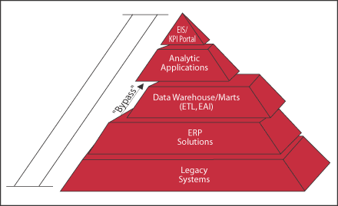
Information Systems Applications within organizations

Slide 18
The Role of the Analyst
Systematically assesses how users interact with technology and how businesses function by examining the inputting and processing of data and the outputting of information with the intent of improving organizational processes.
Many improvements involve better support of user’s work tasks and business function through the use of computerized information systems
The analyst must be able to work with people of all descriptions, and be experienced in working with computers. His three primary roles at any time would be:
As a Consultant ( system consultant to humans and their businesses)
As a Support Expert (within a business where s/he is employed)
As an Agent of change (The analysts presence in a business brings changes; Serves as catalyst of change, develops a plan for change, works with others to facilitate change. To do this effectively, must interact with users and management
Who is a Systems Analyst ?

Slide 19
Qualities of a Systems Analyst
The Successful Systems Analyst must possess a wide range of qualities which include the following:
A Problem solver- views the analysis of a problem as a challenge, and enjoys devising workable solutions
Skillful – Uses necessary skills to tackle the situation at hand
Communicability- A communicator capable of relating meaningfully to others over extended period of time
Computer Skill experience – understands humans needs and capability of computers to glean information requirements from users and to communicate what is needed to programmers
Must possess strong personal and professional ethics

Slide 20
Ethics in the Computing Sciences
Computing Science comprise :
Computer Science
Computer Engineering
Software Engineering
Information Technology
Information System
The same ethics govern professionals in these categories.
Assignment 2 : Find out the professional ethics for computing scientistshttp://www.acm.org/about/code-of-ethics; http://www.acm.org/about/se-code

Slide 21
Integrating Technologies For Systems
As users adopt new technologies, some of the analyst’s work will be devoted to integrating traditional systems with new ones to ensure a useful context
Some of the new technologies the analyst may work with are grouped into the following:
E-commerce and Web Systems
Enterprise Systems
Systems for Wireless and Mobile devices
Open Source Systems

Slide 22
Tutorial 1
What are the benefits of systems migrated to the World Wide Web or originally conceived and implemented as web based technologies? (e-commerce application and web based systems)
What are the benefits of integrating many information systems existing on different management levels and within different functions? (enterprise systems)
Give examples of wireless and mobile devices and applications analysts may be asked to design.

Slide 23
Technology Integration Pyramid
ESS
GDSS
CSCWS
Expert Systems
Decision Support Systems
Management Info Systems
Knowledge Work Systems
Office Automation Systems
Wireless Systems
Enterprise
Systems
E-commerce &
Web based
Systems
Transaction Processing System

Slide 24
SUMMARY
The Key resources of organizations in today’s technology driven world are: People, Information and raw materials.
People: “Human resources have become a key department for every organization. Increasing importance has been placed on the role of managing the work force today. Recognizing that it is the people who make a difference and who can be the source of the organization’s competitive advantage, organizations are placing more emphasis on understanding how to manage this key resource better. Anonymous”. The systems analyst will work with various categories of people in the organization, and at various levels of management- strategic (top level), tactical (middle level) and operational (low level).

Slide 25
Other organizational resources
Information: Information has moved to its rightful place as a key organizational resource. Information resource is often classified into information sources, services and systems.
Sources: The sources of information include books, Documents, journals, Internet, magazines, organizational publications
Services: Providers information services e.g Libraries, vendors
Systems : hardware and software technologies which store relevant data to
provide information
Note that the terms Data and Information are not synonymous. Data ( the plural of datum) are facts, figures or record of events that has occurred or about to occur. Data becomes information when they undergo transformation or are processed to be meaningful and useful for the purpose of making decisions by a user

Slide 26
Attributes of Information
Accuracy: Does the information portray the situation or status as it really is?
Form : Distinctions of forms are qualitative and quantitative, numerical and graphic, priced and displayed, summary and detail
Frequency: How often is the information needed, collected, produced
Breadth: The scope of the information required (broad , narrow)
Origin : Where is the source or origin of the information?
Time horizon: Information may be oriented towards the past, present or future activities and events
Relevance : Information is relevant if it is needed for a particular situation
Completeness: Provides the user with all that needs to be known about a particular situation
Timeliness : Available when it is needed.
The systems analyst needs to know about these attributes of information.

Slide 27
Desirable features in Information Systems (IS)
Must provide information and not data
Every change in the status of data – consequent on decision and resultant action- must be instantaneously reflected in the data base
Must deliver information in formats, at desired times, to the concerned level, in the hierarchy
There should be only one source to change the status of concerned data in the database
Access to a modification of data should be governed by “need-to-know” policies
Other resource of an organization are raw materials, physical (tangible) assets, financial resources (funds available to the organization, and budgets for expenditure

Slide 28
The Systems Analyst as a Professional
The Analysts professional training makes him very useful in the organization
He must seek to understand what humans need to analyse data input or data flow systematically, process or transform data, store data, and output information in the context of a particular organization or enterprise
The rest of this course shall seek to explore more of what is needed in the professional training of systems analysts and designers.

